Slide 1
General methodology
Setup antenna geometry radiating into a homogeneous dielectric domain with PML
Setup PML-like domain around the dielectric domain, check to obtain same results than in 1
Setup anisotropic cold plasma properties instead of dielectric

Slide 2
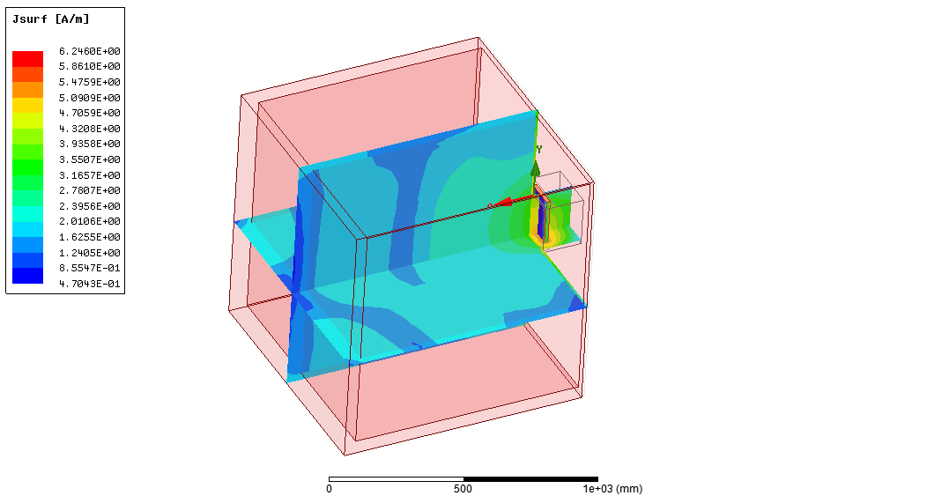
Water case with PML
1% de convergence sur Ra, 50 MHz
PML on 5 external faces

Slide 3

Water case with PML
1% de convergence sur Ra, 50 MHz
Ra = 1.18

Slide 4
Dielectric Case radiation BC

Slide 5
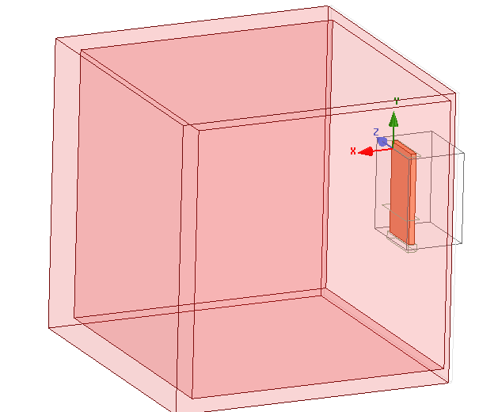
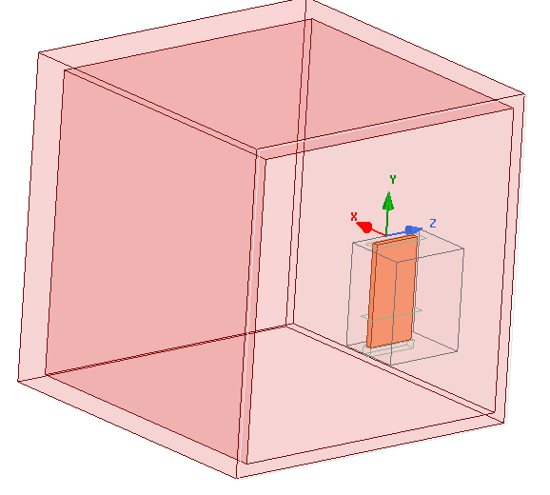
Geometry
Cube of d_vacuum length

Slide 6
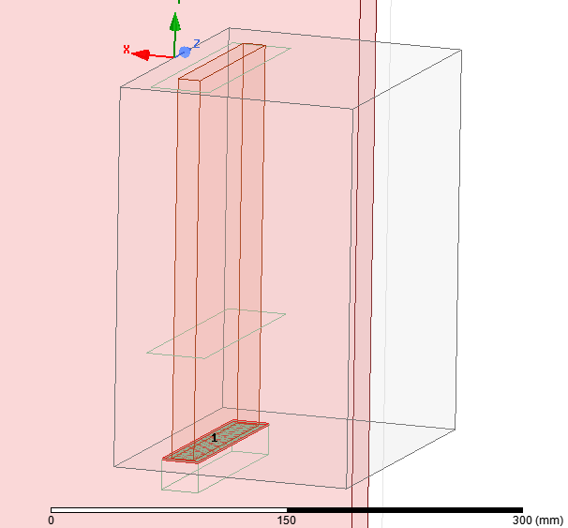
Port
short
Current evaluated @ short
Capped wave port

Slide 7
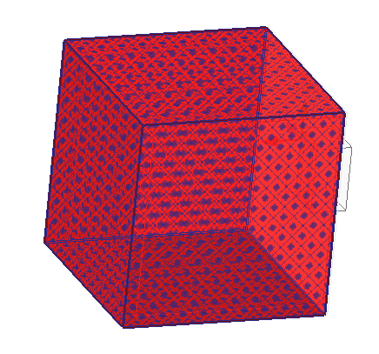
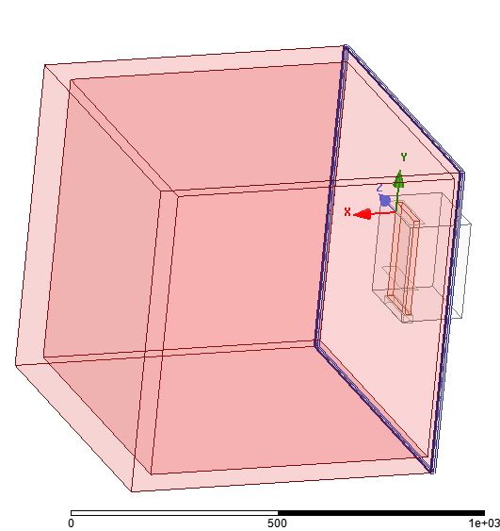
Boundary conditions
h_strap 200mm
Radiation around the dielectric
(5 faces)
Radiation around the vacuum gap (4 faces)

Slide 8
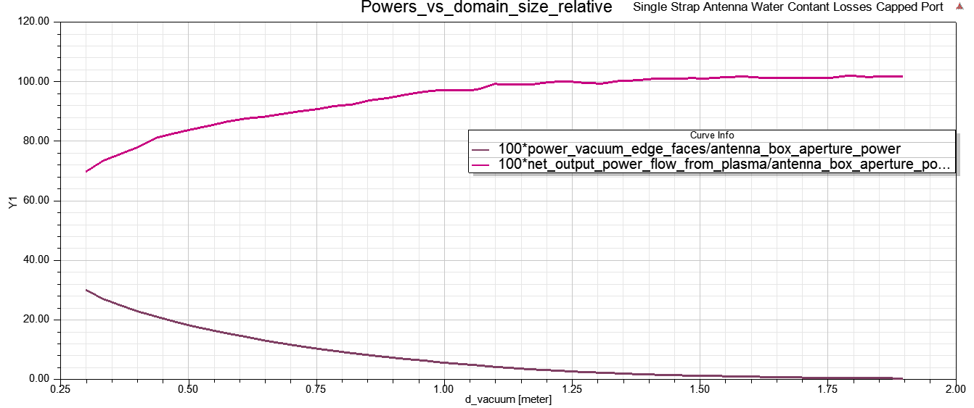
Power convergence vs dielectric domain size The dielectric domain must be large enough, otherwise the fraction of power reaching the radiating BC are different
Fraction of Power radiated from dielectric boundaries
Fraction of Power radiated from vacuum boundaries

Slide 9

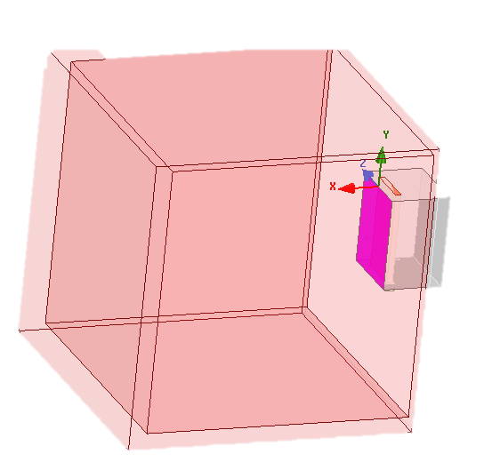
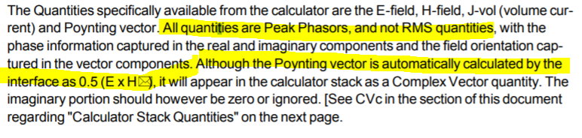
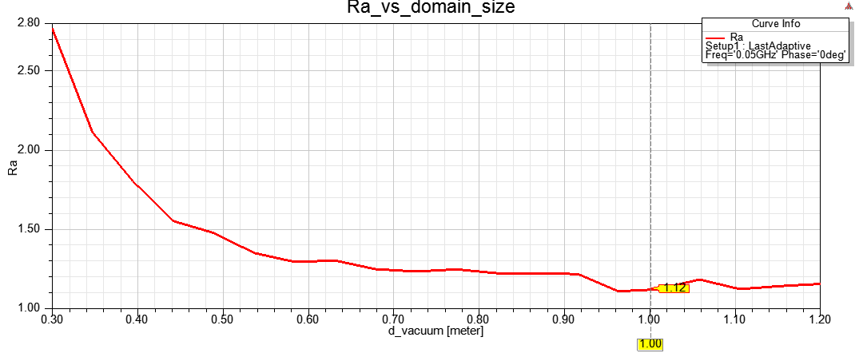
Aperture resistance
Power rad from aperture : int(Re[Poynting].dS)
Defined as :
HFSS current is calculated from H field, so this is a peak quantity.
ANTITER also use peak quantity so the results should match.
ANTITER -- Single strap: Za=(1.1191 + i7.6143)ohm
Ra ~ 1.12

Slide 10
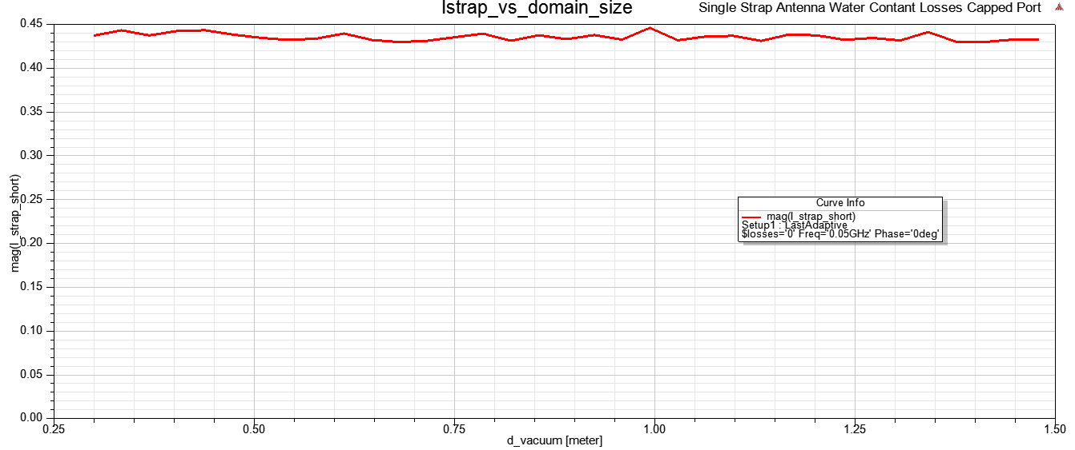
Current
Current ~ constant independently of dielectric size

Slide 11
Dielectric Case PML like

Slide 12
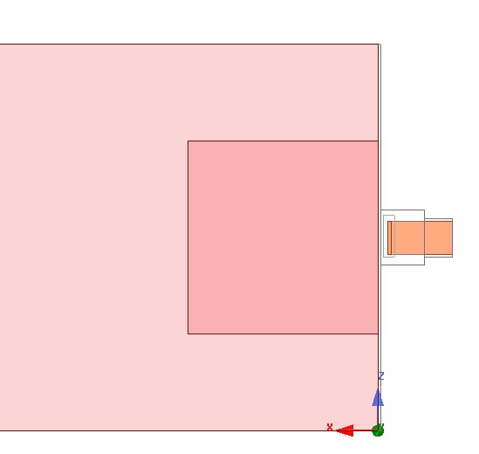
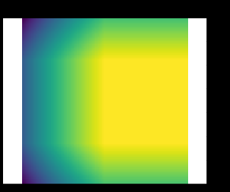
creating a lossy plasma surrounding a low or non-lossy plasma
PerfectE BC
D
d
Plasma1,
Constant losses
ε"(x,z)
ε" = -0.1
Pin
Plasma2,
Increasing losses
Pout
Dummy boundary, close to PerfE BC, just for power calculation purpose

Slide 13
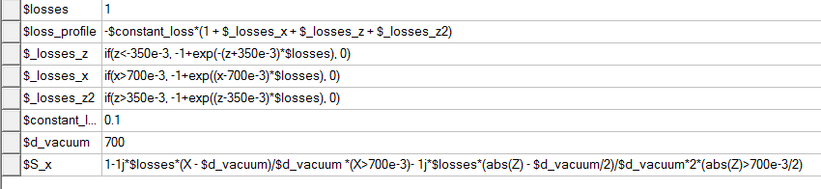
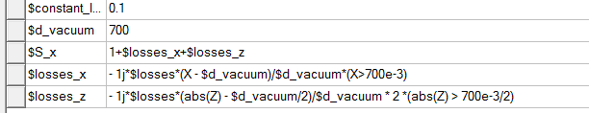
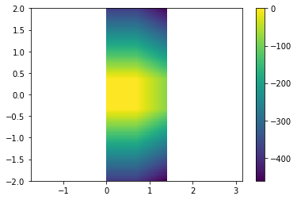
PML-like evolution
Epsr_HFSS = epsr . S(x)

Slide 14
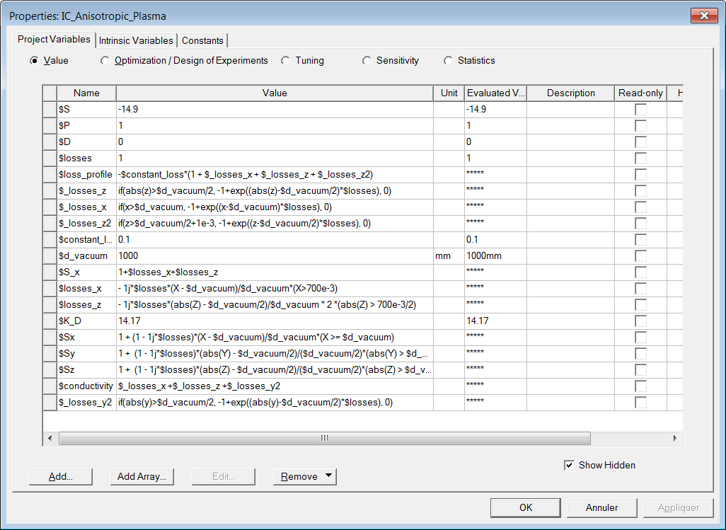
PML-like with increase of the conductivity

Slide 15
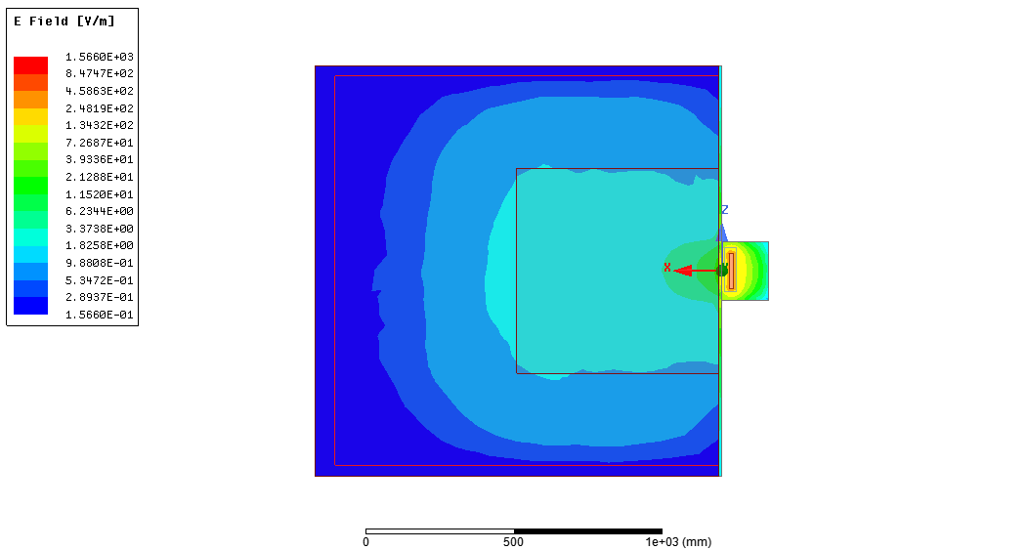
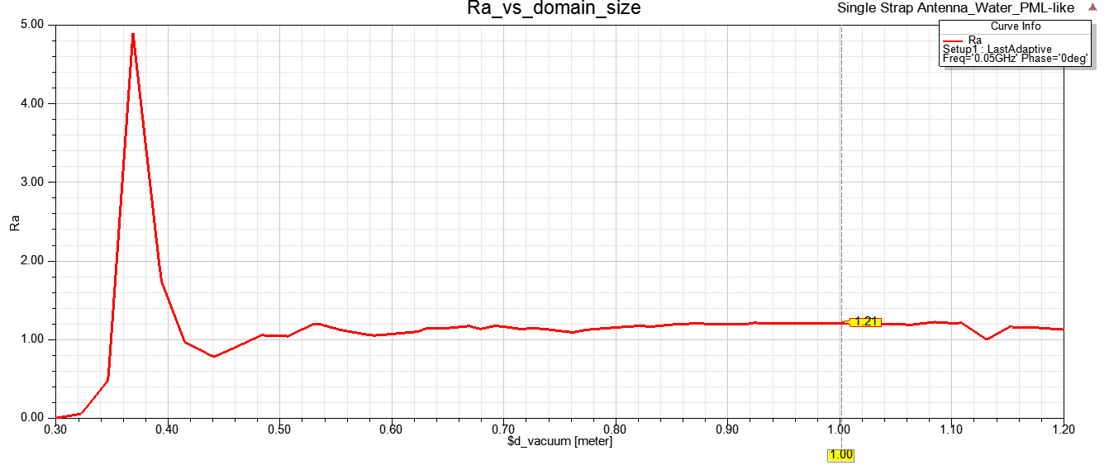
Ra
The results ~matches the case of radiating BC : means the absorption of the RF power is sufficient before it reaches the PEC BC

Slide 16
Equivalent dielectric & cold plasma Constant profile
x_plasma=0.01
n_e0=1e18
n_e0=5e18
n_e0=10 e18
Equivalent dielectric from
A.Messiaen et al. PPPCF 53 2011 08502
x_plasma=0.01
@50 MHz, 3 T
K_D = 14.17
K_D = 66.86
K_D = 132.72
Method |  | 1e18 | 5e18 | 10e18
ANTITER II | R_A (ohm/m) | 0.22 | 1.74 | 4.0
 | Z_A (ohm/m) | 0.22+i96.86 | 1.74+i97.47 | 4+i97.12
 | Z_A (ohm) | 0.044+i19.37 | 0.348+i19.49 | 0.8+i19.42
Equivalent dielectric (different BC) | R_A (hfss) | 0.21 0,20 (PML conductivity) | 0.94 (rad) 1.06 (PML HFSS) 0.96 (PML conductivity) | 2.20 (rad) 2.84 (PML HFSS) 2.24 (PML conductivity)
 | Z1 (hfss) | 0.047+i16.10 0,042+j16,13 0,049+j16,11 (PML conduct) | 0,22+j16,43 (rad) 0,24+j16,45 (PML HFSS) 0,22+j16,43 (PML Conduct) | 0.50+j16.7 (rad) 0.63+j16,43 (PML HFSS) 0.50+j16.7 (PML Conduct)
Cold Plasma and PML conductivity | R_A (hfss) | 1,12
 | Z1 (hfss) | 0,17+j15,8

